Slide 1



National Taiwan University
System Optimization Laboratory
Predictive Velocity Obstacle Method for Mobile Robot Motion Planning Among Dynamic Obstacles with Unknown Intentions

Slide 2
Introduction
Methods
Results
Discussion

Slide 3
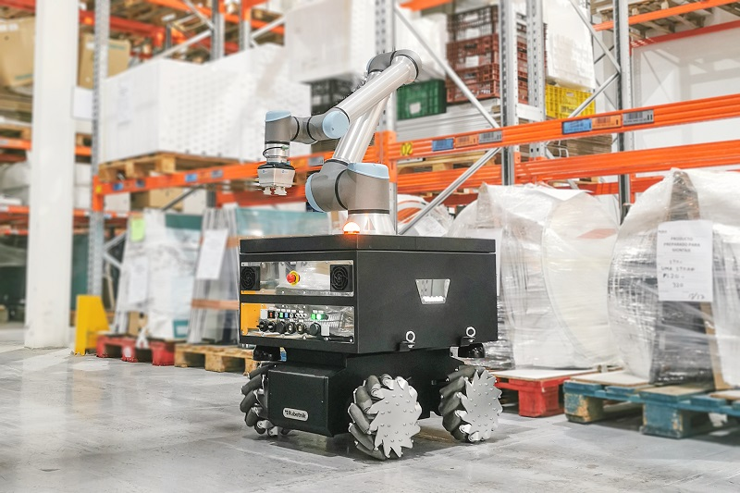

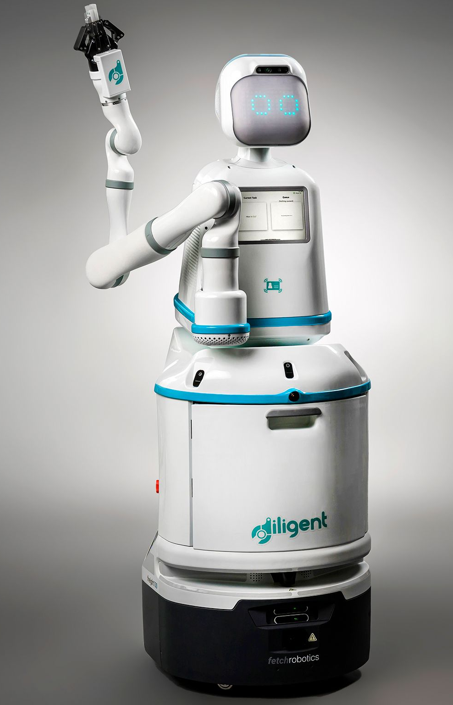


Autonomous Mobile Robots (AMR)
Motion Planning
Introduction
Methods
Results
Discussion
Notes:
As technology improves, there are more and more applications of autonomous mobile robots in different fields, such as in factories, logistics and hospitals. One of the biggest advantages of mobile robots is the ability to transport items and move automatically without direct human control. This not only saves on labor costs but also reduces so much tedious work that people have to do. Because of this, improving the autonomy of AMRs can greatly expand their use, allowing more people to benefit from their capabilities. So, to achieve this, I focus on Motion planning for AMRs, which plays a crucial role in enabling their autonomy.

Slide 4
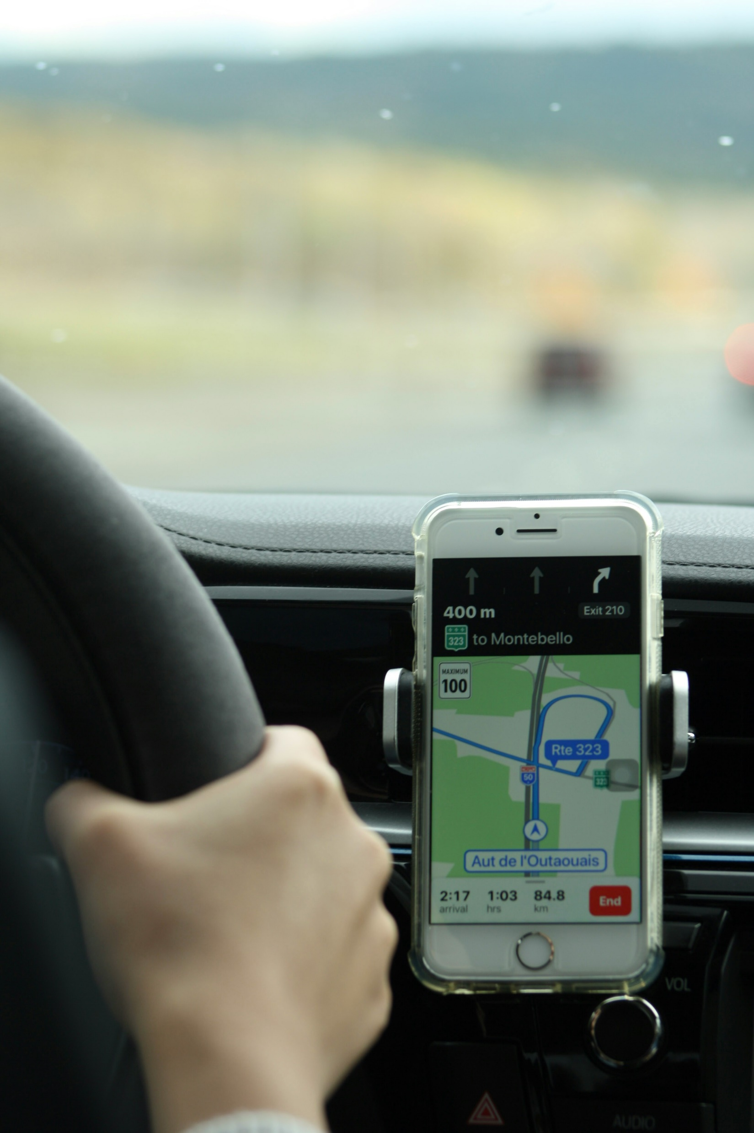
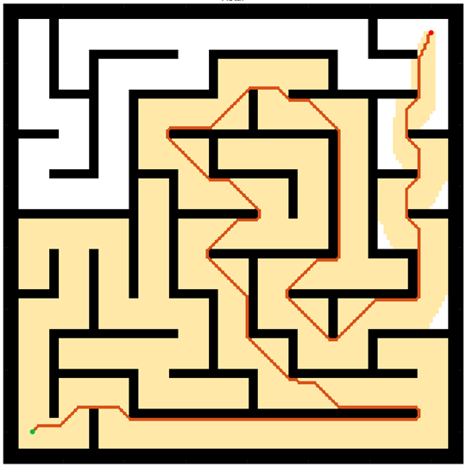
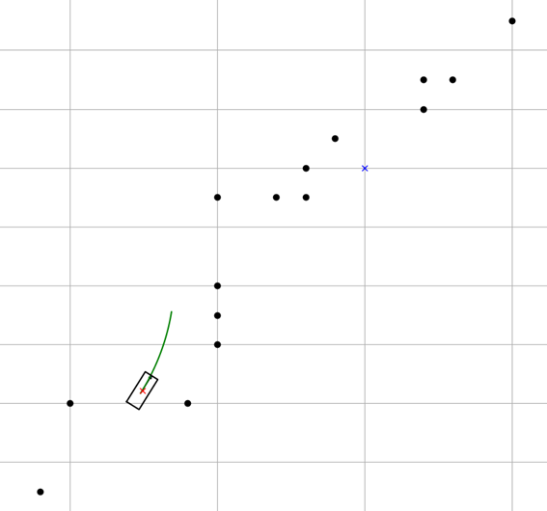
Motion Planning
Motion Planning finds a continuous sequence of valid configurations that safely and efficiently guide a robot from start to goal.
Global Planning
Navigation
Avoiding Static obstacle
Local Planning
Handle emergency
Evading moving objects
Google Map
Global Planning
Driver
Local Planning
Introduction
Methods
Results
Discussion
Notes:
What is Motion planning in the field of robotics? Typically, it finds a continuous sequence of valid configurations that safely and efficiently guide a robot from start to goal. There are two critical parts: global planning and local planning. My research mainly focuses on local planning, but I need to introduce both first.
Global planning is like navigation in Google Maps; it creates a clear route from the starting point to the goal, telling robots how to avoid static obstacles.
On the other hand, local planning must handle all emergencies in real time. It generates a motion command in every short time period that helps robots evade dynamic objects, just like a driver constantly making decisions on the go. Therefore, a better local planning system should help AMRs navigate highly dynamic and complex environments, consequently improving their autonomy.

Slide 5
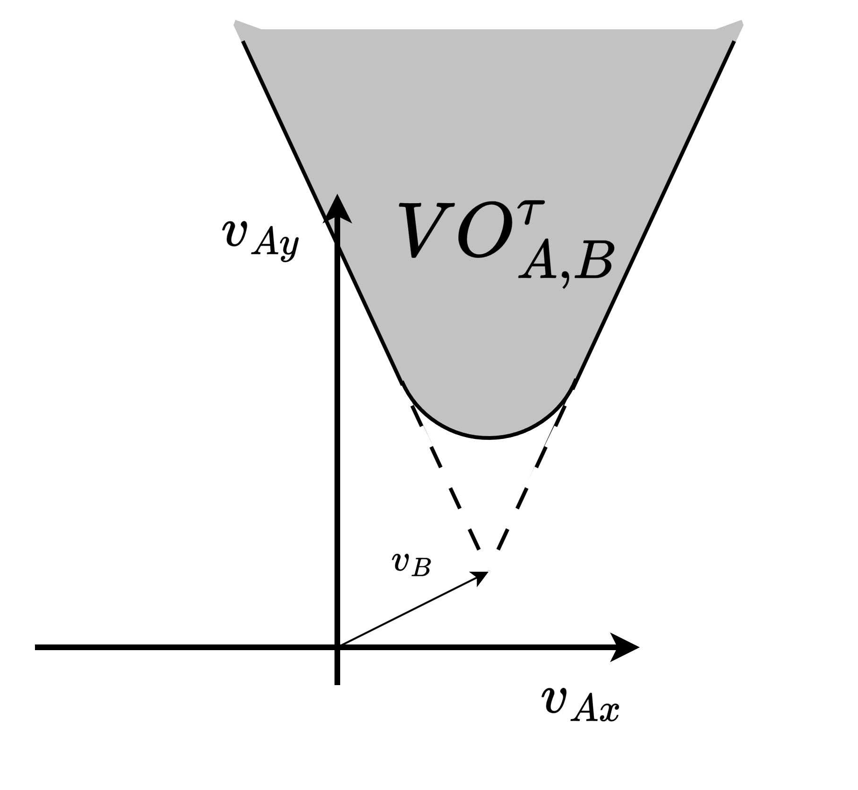
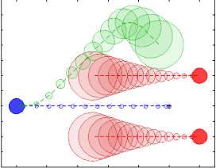
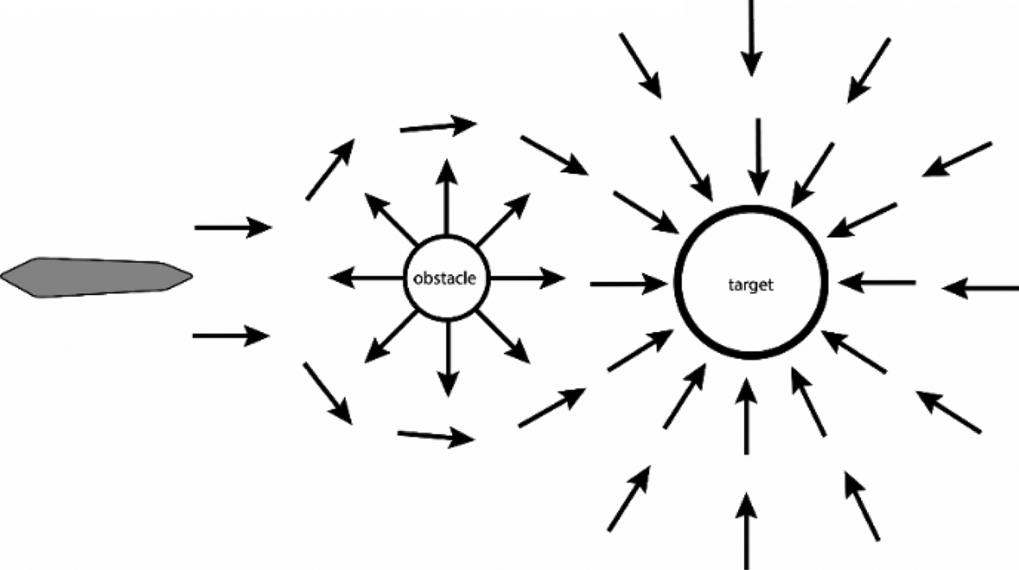
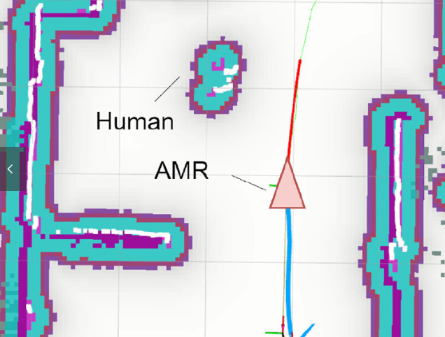
Local Planning
[1] Polvara, Riccardo, et al. "Obstacle avoidance approaches for autonomous navigation of unmanned surface vehicles." The Journal of Navigation 71.1 (2018): 241-256.
[3] Du Toit, N. E. and J. W. Burdick (2010). Robotic motion planning in dynamic, cluttered, uncertain environments. 2010 IEEE International Conference on Robotics and Automation, IEEE.
[2] Wu, C.-H. and K.-Y. Chan (2024). "Developing a dynamic obstacle avoidance system for autonomous mobile robots using Bayesian optimization and object tracking: Implementation and testing." Proceedings of the Institution of Mechanical Engineers, Part C: Journal of Mechanical Engineering Science 238(9): 4007-4022.
Artificial Potential Fields (APF) | Dynamic Window Approach (DWA) | Velocity Obstacles (VO) | Model Predictive Control (MPC)
Simple for real-time avoidance | Effective, Dynamic feasible | Deal with multi-agents systems | Handles robot dynamics
Local minima issue | Struggle with moving obstacles | Poor at handling unknow intensions | Computationally expensive
[1]
[3]
[2]
former lab members’ research
My research want to use
Introduction
Methods
Results
Discussion
Notes:
There are several methods for solving local planning problems, such as Artificial Potential Fields (APF), Dynamic Window Approach (DWA), Velocity Obstacles (VO), and Model Predictive Control (MPC). Among these, VO and MPC are considered the most effective for robots to evade continuously moving obstacles, but both have their drawbacks.
The VO method assumes that every dynamic object moves with a constant speed and heading, making it difficult to handle obstacles without prior knowledge of their intentions. On the other hand, the MPC method allows robots to avoid nonlinear velocity obstacles by planning over a long-term future. However, this approach is computationally intensive, and its long-term predictions about obstacle movements can still be inaccurate.
Therefore, my research aims to combine the VO method with the concept of MPC, seeking to reduce their disadvantages and enhance the avoidance capabilities of AMRs.

Slide 6
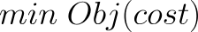
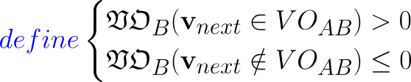
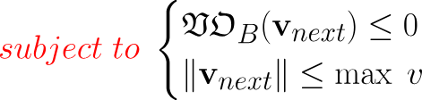

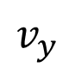
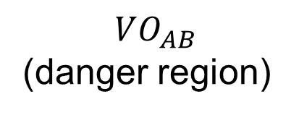
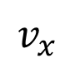
Conventional VO method
Design variables: $v_{next}$
Velocity space
$$v_{y}$$
$$VO_{AB}$$
(danger region)
Dynamic feasible region
Ideal velocity
$$v_{x}$$
Optimal robot’s next step
Introduction
Methods
Results
Discussion
Notes:
Firstly, let me introduce the Velocity Obstacle method. Basically, what this approach does is continuously determine the optimal velocity for the robot to move on.
Conventional VO method has constructed an optimization problem to find the best motion. The design variable “v_next” is the robot’s next motion which the algorithm has to find. We want the robot’s movement to avoid obstacles while still progressing toward its goal. Therefore, this optimal vector must be as close to ideal velocity as possible and lie in the feasible region but stay outside the danger space, as you can see in this picture. The VO block means the danger region, which will be explained more in the following slide. What the algorithm does here is define a VO constraint function. If a motion falls within the VO region, the function's value will be greater than zero, indicating a potential collision. The optimization problem is therefore subject to the condition that the function value must be less than zero. Thus, once the problem is solved, the optimal motion for the robot’s next step will ensure collision-free and closer to the goal point.

Slide 7
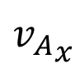
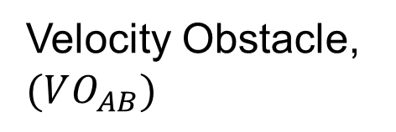
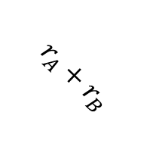
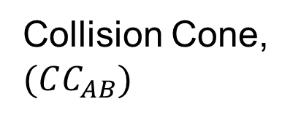
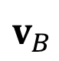
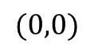
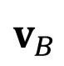
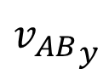
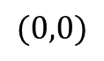
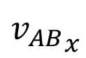
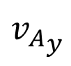
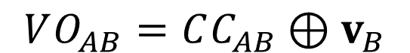
Velocity Obstacle (VO)
$$VO_{AB}=CC_{AB}⊕v_{B}$$
C-space
Velocity space
$${v_{AB}}_{y}$$
$${v_{A}}_{y}$$
Collision Cone, $(CC_{AB})$
Velocity Obstacle, $(VO_{AB})$
$$v_{B}$$
$$r_{A}+r_{B}$$
object B
$${v_{AB}}_{x}$$
$${v_{A}}_{x}$$
$$(0,0)$$
$$(0,0)$$
$$v_{B}$$
agent A (Robot itself)
Introduction
Methods
Results
Discussion
Notes:
How to form a VO region in a robot’s velocity space? Let's take agent A as a robot and object B as an obstacle for example. If an agent A encounters an object B, we can identify a danger region for A's movement. How? Intuitively, we draw two tangent lines from A's center to the inflation circle of object B in the configuration space. This forms a sector region indicating that moving in this direction would be dangerous for agent A.
Next, we change our perspective. By mapping this sector into the velocity space, the region now represents the set of relative velocities that would lead to a collision. This is known as the Collision Cone.
When object B has its own velocity, we need to determine which motions for A are safe or dangerous. To do this, we compute the Minkowski sum of the Collision Cone and B's velocity vector. The resulting region indicates all the dangerous motions for agent A and is referred to as the Velocity Obstacle.

Slide 8
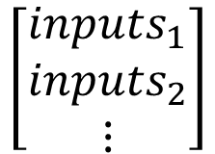
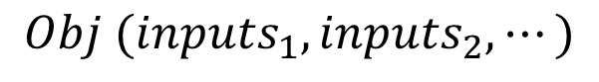
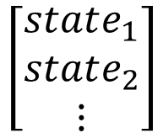
Concept of MPC
1
$$Obj (inputs_{1}, inputs_{2},⋯)$$
minimizing energy usage
moving closer to target state
Optimization problem → add constraints!!
$$\left[\begin{matrix}inputs_{1} \\ inputs_{2} \\ ⋮\end{matrix}\right]$$
System Model
$$\left[\begin{matrix}state_{1} \\ state_{2} \\ ⋮\end{matrix}\right]$$
2
Real System
Find solution → Apply only the 1st control action to
3
Update
System Model
Introduction
Methods
Results
Discussion
Notes:
I’ll briefly introduce the concept of Model Predictive Control. Essentially, MPC uses a mathematical model to predict the future behavior of a system over a specified horizon—for example, a few seconds into the future.
First, we define an objective function that reflects the control goal, such as minimizing energy usage or moving closer to a target state. Since MPC is an optimization problem, we can also add constraints to ensure the solution follows system limitations, like speed limits or obstacle avoidance.
Once the optimal control sequence is solved, only the first control action is applied to the real system. After executing this action, we measure the current state of the system, update the model, and repeat the optimization process again in the next period.
So this is a cycle. We keep doing this until the system reach its goal stably.
(Because MPC evaluates a sequence of control inputs over time and incorporates constraints, it is highly adaptive and is considered a powerful method for handling complex problems, such as dynamic environments or systems with multiple constraints.)

Slide 9
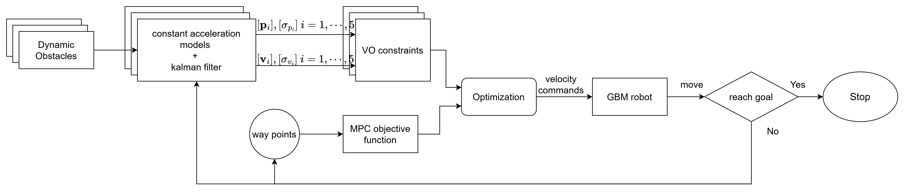
Structure of proposed method
Prediction step
Optimization step
Introduction
Methods
Results
Discussion
Notes:
The proposed method is somewhat similar to MPC’s structure. I seek to determine the optimal sequence of motion commands within a short time horizon to handle different obstacles. This process is structured into two key components: Prediction and Optimization. The Prediction section will estimate the obstacles’ future states. The following optimization should take those as the constraints and generate robots’ next step motions. I will explain more in the following slides.

Slide 10
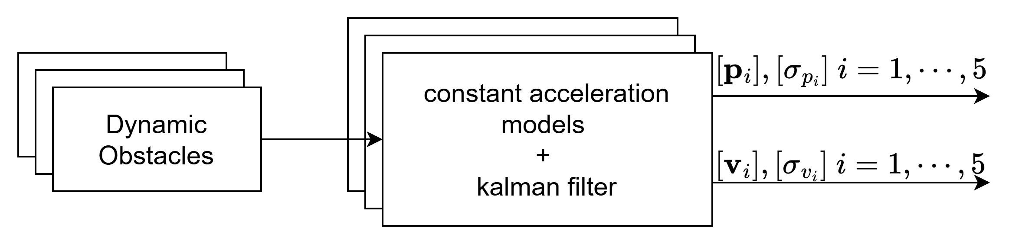
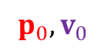

Prediction
Prediction step
Prediction
$$p_{i},v_{i}, i=1,2,3…$$
$$p_{0},v_{0}$$
Observation
Constant Acceleration Model
Dynamic Obstacle
Prediction by Kalman Filter
Introduction
Methods
Results
Discussion
Notes:
In the prediction step, we aim to estimate the movements of surrounding obstacles. To achieve this, I assume that the positions and velocities of all obstacles can be measured and model each observed obstacle as a constant acceleration agent, meaning they maintain the same acceleration over a short time period.
(and) For evaluation, a Kalman Filter is applied to estimate the confidence level of this prediction. Typically, the longer the prediction horizon, the greater the uncertainty, leading to higher variance in the estimates. Consequently, this expands the estimated danger region of the obstacle as in this picture.
(The farther into the future the prediction extends, the larger the predicted uncertainty.)

Slide 11
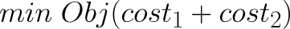
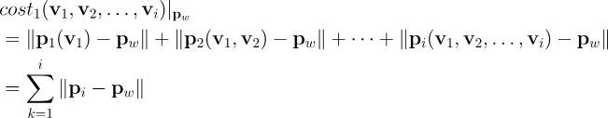
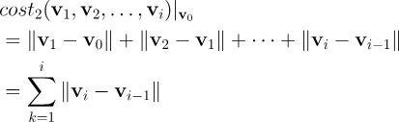
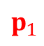
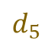


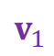
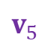
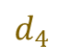
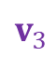

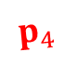
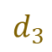

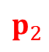
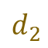
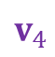
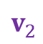
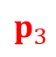
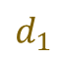
Optimization
$$p_{0}$$
Robot
$$v_{1}$$
$$p_{1}$$
Design variables: $v_{1},v_{2},v_{3},…,v_{i}$
$$v_{2}$$
$$p_{2}$$
Way point distances
$$v_{3}$$
$$p_{3}$$
$$d_{1}$$
$$v_{4}$$
$$d_{2}$$
$$p_{4}$$
$$d_{3}$$
$$v_{5}$$
Velocity change
$$p_{5}$$
$$d_{4}$$
$$d_{5}$$
Way point${ p}_{w}$
Introduction
Methods
Results
Discussion
Notes:
Unlike the conventional VO method, which only determines the next step motion for the AMR, my approach aims to optimize a sequence of velocity vectors over a time horizon, which means that the design variables could be: V1, V2 until Vi.
The objective function consists of two types of cost:
The waypoint distance cost is the sum of distances between the robot’s position at each time step and its corresponding waypoint. Minimizing this could encourage the robot to move efficiently toward its goal.
In addition, the velocity change cost reduces extreme or abrupt motions. This cost penalizes large changes in velocity between consecutive time steps. Minimizing this should make a set of smooth and continuous motions.
By combining these two costs, the objective is to strike a balance between motion efficiency and continuity, ensuring the robot reaches its goal smoothly.

Slide 12










Constraints
Velocity space: $v_{1}$
$$VO_{AB,1}$$
Design variables: $v_{1},v_{2},v_{3},…,v_{i}$
Velocity space: $v_{2}$
$$VO_{AB,2}$$
Velocity space: $v_{3}$
$$VO_{AB,3}$$
Velocity space: $v_{i}$
.
.
.
$$VO_{AB,i}$$
Introduction
Methods
Results
Discussion
Notes:
To ensure that an AMR avoids collisions with obstacles, constraints are applied to the optimization process. The basic idea is to let the robot’s motion at each time step stays outside the corresponding VO region.
The most complex part is constructing the VO constraint function. The robot’s current position and the state of obstacles are treated as parameters. However, when optimizing a sequence of motions over a time horizon, the robot’s future positions also become variables—they depend on the motion choices made in the previous time steps.
As the prediction horizon becomes longer, the dimensionality of the optimization increases, which can significantly slow down computation. Therefore, finding a reasonable prediction horizon is crucial for balancing accuracy and computational efficiency in this approach.

Slide 13



Tested AMR
Generalized Bicycle Model
2 wheels that can rotate and spin independently
Holonomic robot (heading and orientation are decoupled)
rotate
rear wheel
Front wheel
spin
Introduction
Methods
Results
Discussion
Notes:
To test my proposed method, I applied it to a specific type of mobile robot called Generalized Bicycle Mode or the GBM. The GBM has a unique design. Unlike regular vehicles that steer by turning the front wheel, the GBM has two wheels that can rotate and spin independently. This design allows it to move in any direction without changing its orientation—just as you can see in this picture! This flexibility makes the GBM highly maneuverable.

Slide 14


Simulation Result
method | Conventional VO | Expanded VO
collision | Collide | safe
Reach time | 19.98 second | 16.84 second
start
goal
GBM
Obstacle 1
Obstacle 2
Introduction
Methods
Results
Discussion
Notes:
To see how well this algorithm works, I ran a simulation on the computer. In this experiment, the GBM had one simple mission: move from point A to point B. Along the way, it encountered dynamic obstacles moving across in a S-shaped trajectory. The robot’s job was to avoid these objects and still reach its goal.
After testing the proposed approach and comparing it to the conventional VO method, two significant results were observed: First, the proposed method successfully guided the robot to its destination without collisions. Second, compared to the existing method, the new approach reduced the total travel time, indicating improved efficiency.

Slide 15
Discussion
Contribution: this research proposes an obstacles-avoidance method that can handle unknown intentions effectively.
Future works:
Adjust the prediction horizon or modify the step length based on the accuracy of the predictions.
Adding more dynamic obstacles to the simulations and making their movements highly irregular.
Low Accuracy
High Accuracy
Irregular Movements
More Obstacles
Introduction
Methods
Results
Discussion
Notes:
Here is why this research matters: it proposes an obstacles-avoidance method that can handle unknown intentions effectively.
However, there are still a couple of things that need to be done. First, I need to adjust the prediction horizon or modify the step length based on the accuracy of the predictions.
Next, I plan to test the algorithm in more diverse scenarios, including adding more dynamic obstacles to the simulations and making their movements highly irregular.

Slide 16
National Taiwan University
System Optimization Laboratory
Predictive Velocity Obstacle Method for Mobile Robot Motion Planning Among Dynamic Obstacles with Unknown Intentions

Slide 17


Introduction of Path Planning
B
A
Global Planning
Local Planning
Introduction
Methods
Results
Discussion

Slide 18










Optimization step
Minimize
Way point distances
Objective Function (design variable: $v_{i}, i=1,2,3…$)
= ∑ way point distances + ∑ change amount of velocity
Subjected to:
Velocity Obstacles
Way point
Change amount of velocity
$$d_{5}$$
$$d_{4}$$
Optimization step
$${||∆v}_{i}||$$
$$d_{3}$$
$$d_{2}$$
$$v_{i}$$
$$d_{1}$$
$$v_{i−1}$$
Robot
Velocity space
Introduction
Methods
Results
Discussion

Slide 19








Optimization step -- VO
$$v_{y}$$
$$v_{y}$$
Collide in $τ$ seconds → danger
$$VO_{AB}$$
$$VO_{AB}^{τ}$$
Collide after $τ$ seconds → relatively safe
Ideal velocity
Cut off the relatively safe region
Dynamic feasible region
$$v_{x}$$
$$v_{x}$$
Introduction
Methods
Results
Discussion

